Slide 1

Topics
•
Access Modifiers in Java
(https://docs.oracle.com/javase/tutorial/java/j avaOO/accesscontrol.html)
1
Object-Oriented Programming Using Java

Slide 2
What are Access Modifiers
•
Helps
the
programmer
to
decide
access
levels
for the
instance fields and methods of the class
Encapsulation is supported via Access Modifiers
Scope/Visibility/Access Privileges of the ‘Instance
‘Methods’ of a class is determined via their Access
Java Provides following
•
•
Fields’ and
Modifiers
•
1.
2.
3.
4.
public (Highest Access/Privilege Level )
protected
private (Least Privilege Level)
package-private (Default Modifier – if no access modifier
is used)
Note: package-private is not a Java Keyword.
2
Object-Oriented Programming Using Java

Slide 3
A Simple Example
class Student
{
private
String
int
String
name;
age;
idno;
// name of student (Access Level : private)
// age of student (Access Level: package-private)
// id number of student ( Access Level : protected)
protected
public String
{
return name;
}
getName()
public void
{
System.out.println(“Name :”+ name);
System.out.println(“Age : “+ age);
}
display()
}// End of class Student
Decreasing Access Level
Highest Access Level
public
Lowest Access Level
private
protected
package-private
3
Object-Oriented Programming Using Java

Slide 4
Access Locations
•
Places from where a member of class can be
accessed/referenced
Five Possible Access Locations
•
1.
2.
3.
4.
5.
From
From
From
From
From
within a class itself
other classes in the same package
sub-classes defined with-in the same
package
sub-classes defined in some other
classes defined in other packages
packages
4
Object-Oriented Programming Using Java

Slide 5
Access Locations : Example
Consider
the
Following
Package
Hierarchy
PackA
PackB
PackX
B1,B2,B3
X1,X2,X3
PackC
PackD
PackY
PackZ
C1,C2
D1,D2
Y1,Y2
Z1,Z2
•
B1,B2 and B3 are classes in package PackB. Similarly classes X1,X2 and X3 belongs
to package PackX. C1,C2 classes belongs to PackC. D1,D2 classes belongs to PackD.Y1,Y2 classes belongs to PackY. Z1,Z2 and Z3 classes belongs to classes PackZ.
Assume class B3 (package PackB) is a sub-class of B1 (package PackB). Assume class Z2 (package PackZ) is a sub-class of B2 (package PackB).
•
•
5
Object-Oriented Programming Using Java

Slide 6
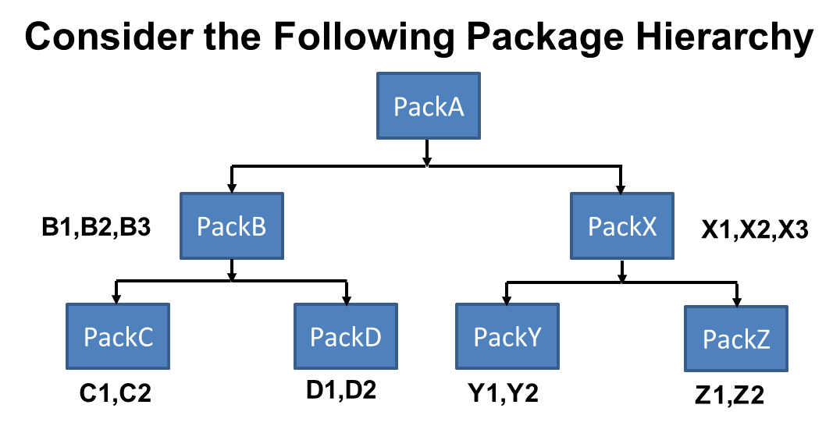
Access
Locations
:
Example
B1
<<super class>>
B2
<<super class>>
B3
<<sub class>>
Z2
<<sub class>>
B1 and B3 belongs to
Same Package PackB
B2 belongs to Package Pack B
Z2 belongs to Package PackZ
6
Object-Oriented Programming Using Java

Slide 7
Visibility
of
Fields/Methods
Access
Modifiers
public
protected
package- private
private
With in the Same Class
Sub-Classes in same package
Access Locations
Other Classes in same package
Subclasses in other packages
Non-subclasses in other packages
7
Object-Oriented Programming Using Java

Slide 8
Visibility
of
Fields/Methods
Access
Modifiers
public
protected
package- private
private
With in the Same Class
Yes
Yes
Yes
Yes
Sub-Classes in same package
Access Locations
Other Classes in same package
Subclasses in other packages
Non-subclasses in other packages
8
Object-Oriented Programming Using Java

Slide 9
Visibility
of
Fields/Methods
Access
Modifiers
public
protected
package- private
private
With in the Same Class
Yes
Yes
Yes
Yes
Sub-Classes in same package
Yes
Yes
Yes
No
Access Locations
Other Classes in same package
Subclasses in other packages
Non-subclasses in other packages
9
Object-Oriented Programming Using Java

Slide 10
Visibility
of
Fields/Methods
Access
Modifiers
public
protected
package- private
private
With in the Same Class
Yes
Yes
Yes
Yes
Sub-Classes in same package
Yes
Yes
Yes
No
Access Locations
Other Classes in same package
Yes
Yes
Yes
No
Subclasses in other packages
Non-subclasses in other packages
10
Object-Oriented Programming Using Java

Slide 11
Visibility
of
Fields/Methods
Access
Modifiers
public
protected
package- private
private
With in the Same Class
Yes
Yes
Yes
Yes
Sub-Classes in same package
Yes
Yes
Yes
No
Access Locations
Other Classes in same package
Yes
Yes
Yes
No
Subclasses in other packages
Yes
Yes
No
No
Non-subclasses in other packages
11
Object-Oriented Programming Using Java

Slide 12
Visibility
of
Fields/Methods
Access
Modifiers
public
protected
package- private
private
With in the Same Class
Yes
Yes
Yes
Yes
Sub-Classes in same package
Yes
Yes
Yes
No
Access Locations
Other Classes in same package
Yes
Yes
Yes
No
Subclasses in other packages
Yes
Yes
No
No
Non-subclasses in other packages
Yes
No
No
No
12
Object-Oriented Programming Using Java

Slide 13
Access Modifiers : Summary
•
<<private> members of a class say ‘C’ are visible only in
side the class ‘C’
<<package-private>> members of class ‘C’ are visible in the all the classes of the package to which the class ‘C’ belongs
<<protected>> members of class ‘C’ are visible in (i) all the classes of the package to which the class ‘C’ belongs and (ii) all the sub-classes of ‘C’
<<public>> members of class ‘C’ are visible to every other
class belonging to the same or any other package
•
•
•
Decreasing Access Level
Highest Access Level
public
Lowest Access Level
private
protected
package-private
13
Object-Oriented Programming Using Java

Slide 14
Thank
You
14
Object-Oriented Programming Using Java

